Slide 1



A Comprehensive Data Analysis on Medical Expenses
Medical Cost Analysis
Presentation
Vinit Solanki
Click here to watch video

Slide 2




Basic Statistics And Data Understanding
Overview of Key Metrics To gain an initial understanding of the dataset, we analyzed key statistical measures for BMI, Age, and Medical Charges. These metrics provide insights into the distribution and variability of health-related factors across individuals.
Average Values and Trends The average BMI is 30.663, indicating a trend towards overweight or obesity among individuals in the dataset. The average age is 39.207, suggesting that the dataset includes a mix of younger and older beneficiaries. Additionally, the average medical charges amount to 13,270.422, highlighting significant healthcare expenses.
Central Tendency and Dispersion The median values for BMI (30.4), age (39), and charges (9,382.033) provide insights into the middle of the data distribution. The standard deviation for BMI (6.098), age (14.050), and medical charges (12,110.011) indicate considerable variation, particularly in medical costs, where some individuals have significantly higher expenses.
Key Observations The high standard deviation in medical charges suggests substantial disparities in healthcare costs, likely influenced by factors such as chronic conditions, insurance status, or hospitalization needs. The relatively consistent median and average age values indicate a balanced representation across different age groups.

Slide 3
Gender-Based Analysis
Comparison of Medical Charges and BMI by Gender This section analyzes the differences in average medical charges and BMI between male and female beneficiaries. The goal is to determine which gender incurs higher healthcare costs and whether BMI varies significantly across genders.
Key Findings
The average BMI for males (30.94) is slightly higher than for females (30.37), indicating minimal variation in body mass index across genders.
The average medical charges for males (13,956.75) are notably higher than for females (12,569.58), suggesting that male beneficiaries, on average, incur more healthcare costs.
The overall average medical charge across all individuals is 13,270.42.
Visual Representation A bar chart will be used to represent the comparison of BMI and medical charges between males and females. This visual aid helps in understanding cost variations and BMI differences in an intuitive manner.
Healthcare Cost & BMI Comparison by Gender
Row Labels | Average of bmi | Average of charges
female | 30.37774924 | 12569.579
male | 30.9431287 | 13956.751
Grand Total | 30.66339686 | 13270.422

Slide 4
Impact of Smoking on Medical Costs
Comparison of Medical Charges for Smokers and Non-Smokers
Smoking is a significant factor affecting healthcare expenses and insurance costs. This section analyzes the difference in average medical charges between smokers and non-smokers to highlight the financial impact of smoking-related health issues.
Key Findings
Smokers incur significantly higher medical charges (32,050.23) compared to non-smokers (8,434.27).
The average medical charge for all individuals is 13,270.42.
The stark difference in costs emphasizes the increased healthcare expenses associated with smoking-related health risks.
Visual Representation
A bar chart will be used to illustrate the cost disparity between smokers and non-smokers, making it easier to interpret the financial impact of smoking on medical expenses.

Slide 5
Thynk Unlimited
Dependents Analysis
Impact of Dependents on Medical Costs
To determine whether the number of dependents influences medical expenses, we analyzed the relationship between dependents and average medical charges. While an increase in dependents is expected to correlate with higher medical costs, further analysis using correlation measures and scatter plots helped verify the strength of this relationship.
Key Findings
Individuals with three dependents have the highest average medical charges (15,355.32), followed by those with two dependents (15,073.56).
Individuals with zero dependents have an average medical charge of 12,365.98, which is lower than those with dependents.
Interestingly, individuals with five dependents have the lowest average medical charges (8,786.04), which deviates from the expected trend.
The overall average medical charge across all categories is 13,270.42.
I

Slide 6
Row Labels | Average of bmi | Average of charges
northeast | 29.17350309 | 13406.38452
northwest | 29.19978462 | 12417.57537
southeast | 33.35598901 | 14735.41144
southwest | 30.59661538 | 12346.93738
Grand Total | 30.66339686 | 13270.42227
Geographical Insights
Regional Variation in Medical Costs and BMI
The dataset provides insights into medical charges and BMI across four U.S. regions: Northeast, Southeast, Southwest, and Northwest. The goal of this analysis is to determine whether location influences healthcare costs—potentially due to differences in lifestyle, access to healthcare, or regional policies.
Key Findings
Southeast has the highest average BMI (33.36) and the highest medical costs (14,735.41), indicating a possible correlation between higher BMI and increased medical expenses.
Northeast has relatively lower BMI (29.17) but higher medical charges (13,406.38) than the Northwest and Southwest.
Northwest and Southwest have the lowest medical costs at 12,417.58 and 12,346.94, respectively.
The overall average BMI is 30.66, and the overall average medical charge is 13,270.42.

Slide 7
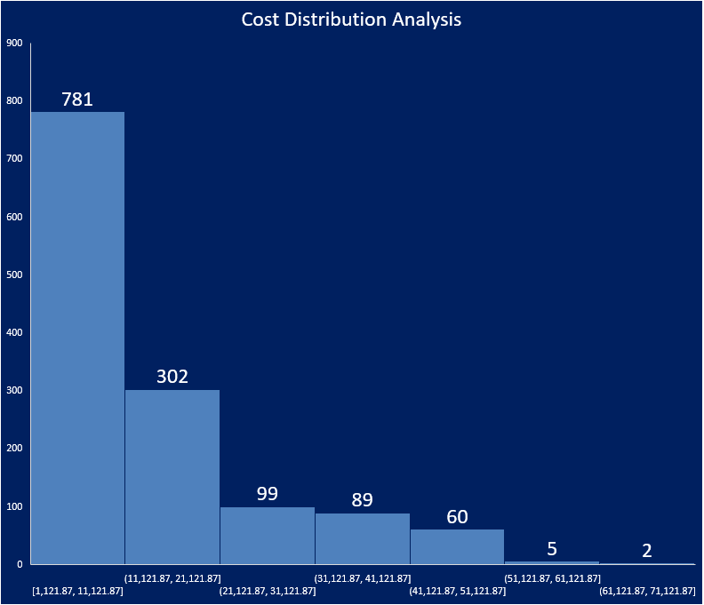
Thynk Unlimited
Cost Distribution Analysis
Understanding the Spread of Medical Expenses
To gain insights into the distribution of medical charges, we used a histogram to visualize the frequency of different cost brackets. This analysis helps identify common cost ranges, detect the presence of high-cost outliers, and understand the overall spread of healthcare expenses.
Key Findings
The most common cost range is between 1,121.87 and 11,121.87, with 781 beneficiaries falling into this category.
As medical charges increase, the number of beneficiaries in each range significantly decreases.
Only seven beneficiaries have medical costs exceeding 51,121.87, indicating high-cost outliers in the dataset.
The Data Analysis ToolPak and the FREQUENCY function were used for precise cost distribution calculations.

Slide 8
Thynk Unlimited
BMI Classification
Assessing Health Trends Among Beneficiaries
Analyzing BMI distribution helps in understanding the prevalence of weight-related health risks among beneficiaries. By segmenting individuals into different BMI categories, we can assess potential health concerns and their impact on medical costs.
Key Findings
The majority of beneficiaries fall into the Overweight (25-29.9) category, with an average of 1,318 beneficiaries.
A small number (20) are classified as Underweight (<18.5) on average.
No beneficiaries were classified as Normal (18.5-24.9) or Obese (30+), which could indicate a data limitation or reporting error.
The Grand Total across all categories is an average of 334.5 beneficiaries.
COUNTIFS and VLOOKUP functions were used to segment and count individuals in each BMI category accurately.
Relevance to Healthcare Costs
A high number of overweight individuals suggests an increased likelihood of future medical expenses due to weight-related conditions such as diabetes, hypertension, and cardiovascular diseases. Further data validation may be required to confirm the accuracy of missing BMI categories.
Row Labels | Average of Beneficiaries
Underweight(<18.5) | 20
Normal(18.5-24.9) | 0
Overweight(25-29.9) | 1318
Obese(30+) | 0
Grand Total | 334.5

Slide 9
Thynk Unlimited
Advanced Correlation Analysis
Examining the Relationship Between BMI and Medical Charges
A deeper correlation analysis helps assess whether individuals with higher BMI tend to have higher medical expenses. This is crucial for identifying patterns that may indicate increased healthcare costs due to weight-related health conditions.
Key Insights
A scatter plot with a trendline was created to visualize the correlation between BMI and medical charges.
The CORREL function was used to calculate the correlation coefficient, quantifying the strength of this relationship.
The red dotted trendline indicates a positive correlation, suggesting that higher BMI is generally associated with higher medical expenses, although some variability exists.
Outliers indicate that some individuals incur significantly high medical charges, possibly due to underlying health conditions unrelated to BMI.

Slide 10
Smoking and Region Interaction
Row Labels | Average of charges
northeast | 9165.531672
northwest | 8523.488627
southeast | 8068.708627
southwest | 8019.284513
Grand Total | 8435.882197
Key Findings:
Smokers incur significantly higher medical expenses across all regions, with an overall average cost of $32,105.78.
The Southeast region has the highest average medical cost for smokers at $34,844.99.
The Northeast has the lowest average for smokers at $29,673.54.
Non-Smokers have considerably lower medical costs, averaging $8,435.88 across all regions.
The Northeast has the highest cost among non-smokers at $9,165.53, while the Southwest has the lowest at $8,019.28.
Insights:
The drastic cost difference between smokers and non-smokers underscores the impact of smoking on healthcare expenses.
The Southeast region consistently reports the highest costs, possibly indicating higher medical service rates or increased risk factors.
Pivot Tables and Slicers were used to filter results dynamically by smoking status and region, making it easier to analyze cost variations.
Smokers
Row Labels | Average of charges
northeast | 29673.53647
northwest | 30192.00318
southeast | 34844.99682
southwest | 32538.96068
Grand Total | 32105.78241
Non- Smokers

Slide 11

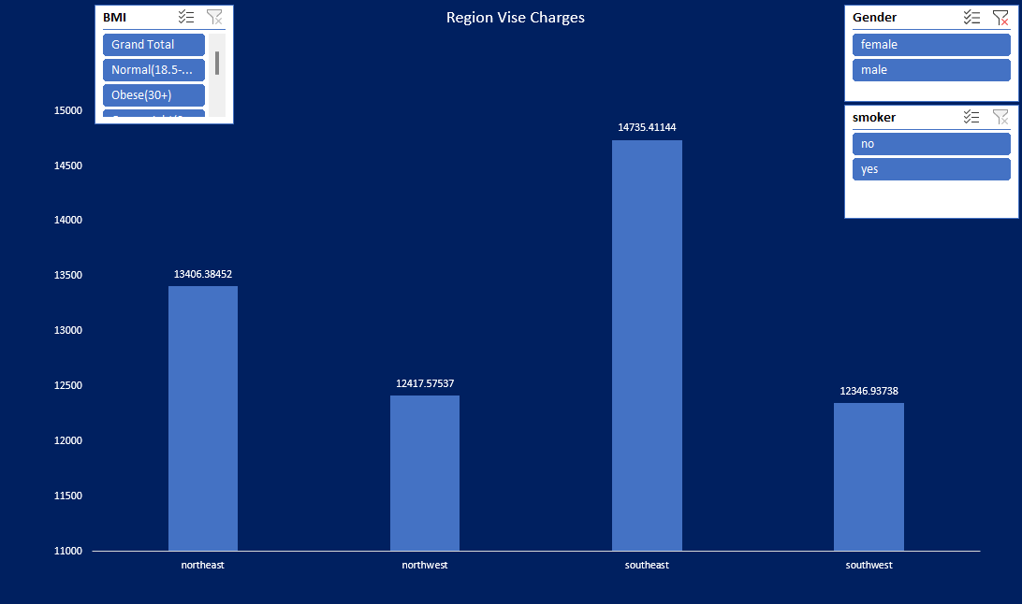

Dashboard for Stakeholders
-

Slide 12
Thank you
Data Speaks. Insights Lead.
-

